Slide 2
Building Future
Through Education
Fundación CIFAN and Amigos Holanda
July 2012| Valdivia, Chile

Slide 3
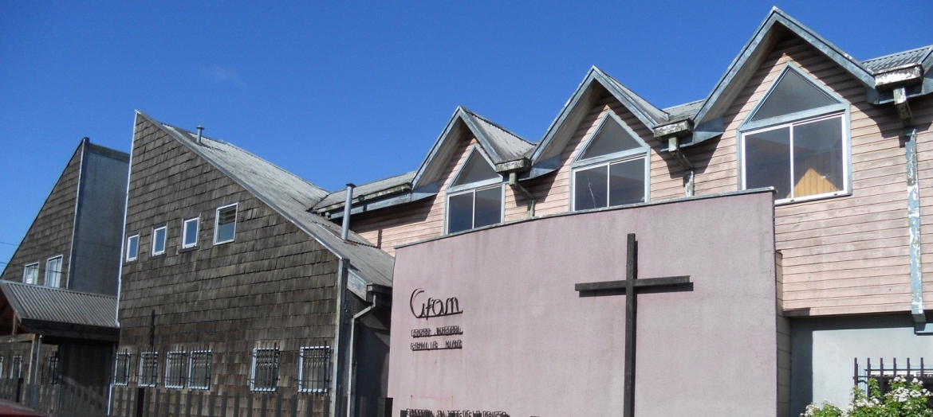
Fundación CIFAN
About Fundación CIFAN
Since its establishment, 19 years ago, Fundación CIFAN improves social life of children and adolescents in Valdivia and Región de los Ríos, providing specialized care and human resources devoted to personal development of them.
Goals Achieved:
Developing personal skills and capabilities, including: self-esteem, self-discipline, team-work.
Promoting values.
Reintegration to a social and working life.

Slide 4
3
Specialized Intervention and Prevention Programs

Slide 5
Fundación CIFAN
What Does Fundación CIFAN Do?
Click on the image

Slide 6
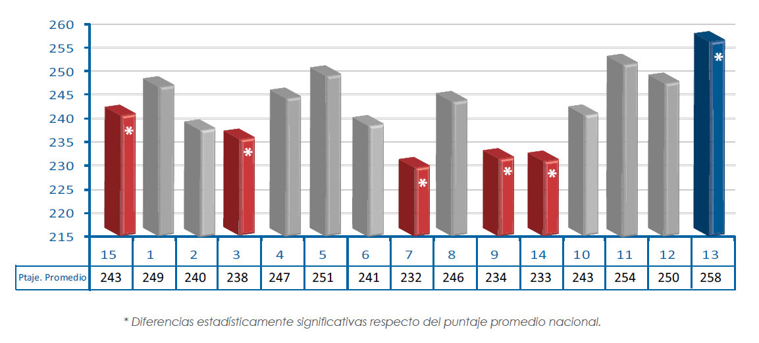
Fundación CIFAN
Chilean Education is Unequal
The measurement system of quality of the education (SIMCE) shows education in Valdivia and Región de Los Ríos below to the national average.
Fundación CIFAN is located here, therefore, the children are affected by this situation.

Slide 7
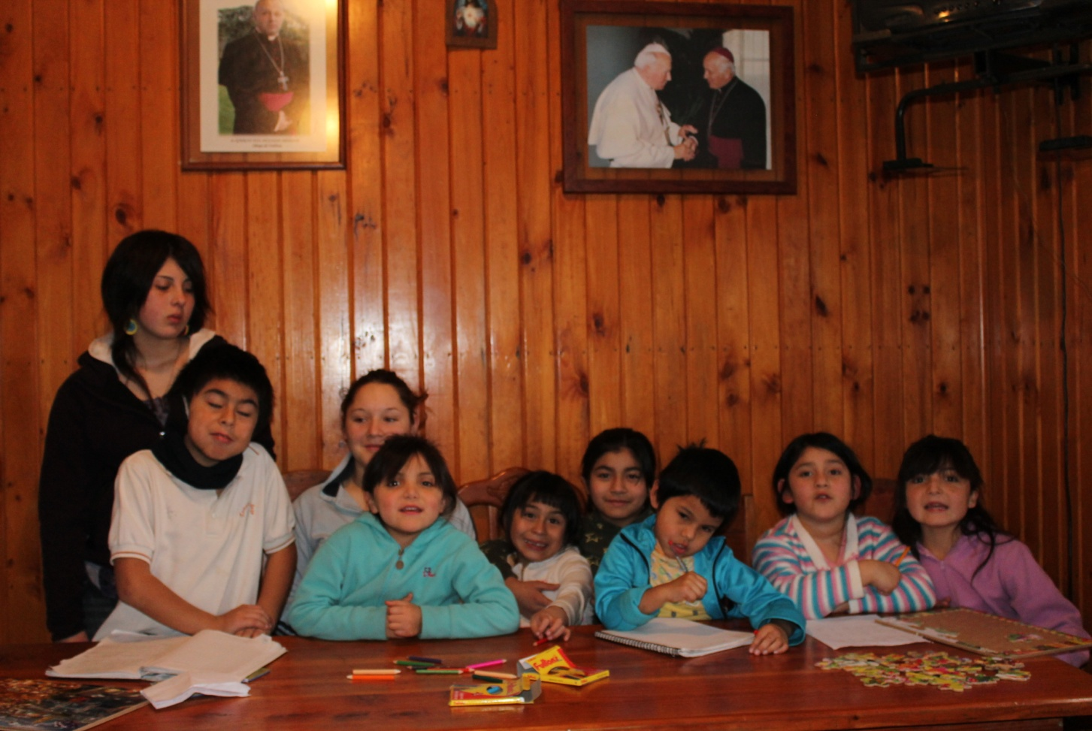
Fundación CIFAN
Beneficiaries of the Project
The beneficiaries of the project are twelve: children and adolescents. They live in our CIFAN host family.
They are waiting for you help.

Slide 8
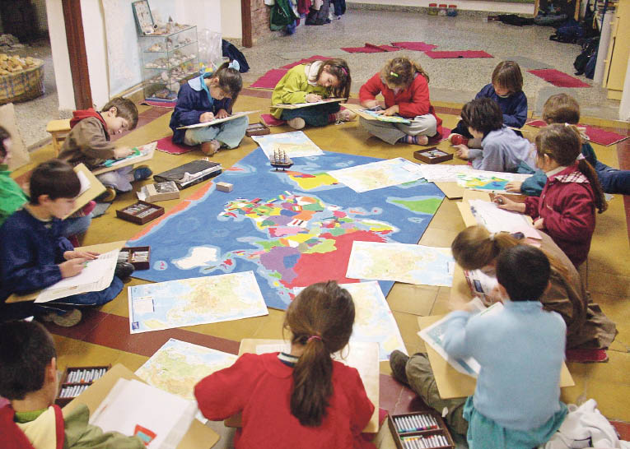
Fundación CIFAN
Main Objetive
To support children and adolescents, giving them fundamental contents on: reading, math, science and languages. Besides, providing integral development to children, trough specialized and differentials methodologies.

Slide 9
What we give to children,
children will give back to society

Slide 10
Follow us
Help us to help
www.cifan.cl
Thank you for
your support

